Slide 1

ZOMATO RESTAURANTS ANALYSIS (USING DATASET FROM ZOMATO)
BI MINI HACKATHON
Made By:
Aniket Kumar PF45(1032171203)
Manish Yadav PD15(1032170265)
Rahul Arya PE20(1032170742)

Slide 2
Restaurants Analysis using Machine Learning Algorithm for Zomato using R Programming
Zomato is an Indian restaurant aggregator and food delivery start-up. As of 2019, Twitter has more than 152 million daily active users . Zomato provides information, menus and user-reviews of restaurants as well as food delivery options from partner restaurants in select cities.
Restaurants Analysis is the process of determining the best restaurants , value for money restaurants in their locality. It also helps to find their required cuisines in their locality.

Slide 3
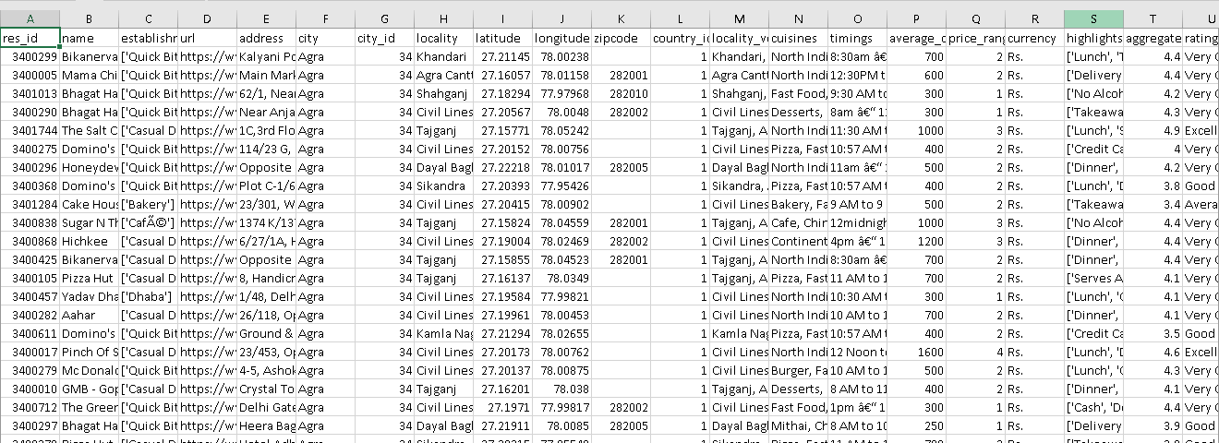
Dataset
The dataset (csv) format consists of 211945 rows and 26 columns.

Slide 4
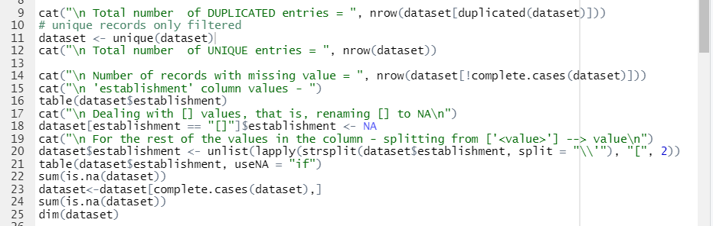
Pre-Processing
In pre-processing, we removed the duplicated values first, then we removed the records with missing data, since the missing data was irreplaceable and small as compared to total amount of data we have.

Slide 5
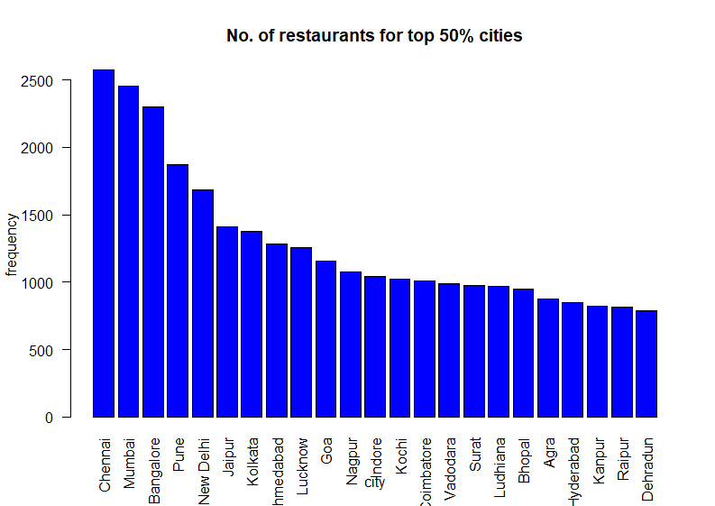
Visualisations Bar-Plot
Number of Restaurants in Major cities

Slide 6
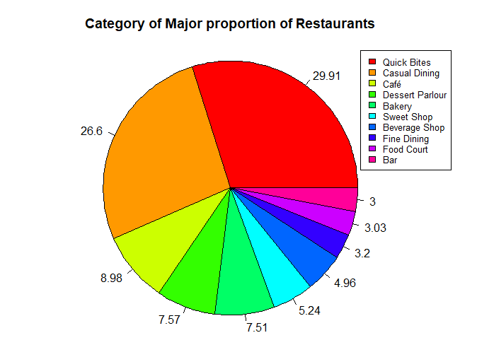
Visualisations Pie Chart
Category of Major proportion of restaurants

Slide 7
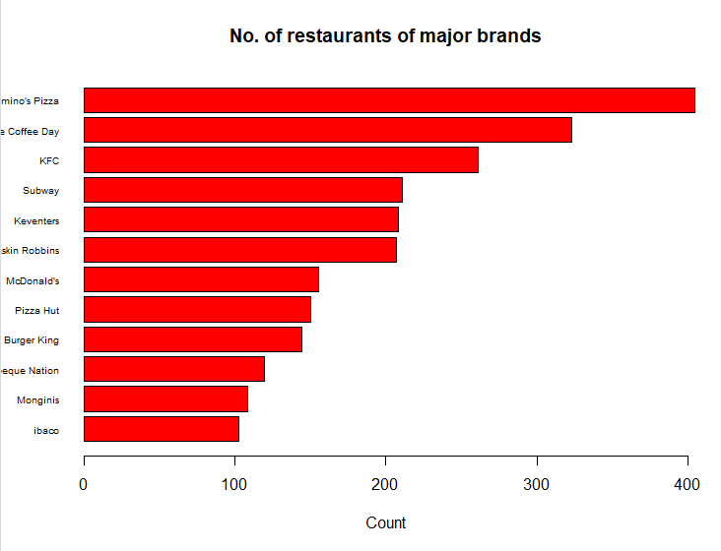
Visualisations Horizontal BarPlot
Votes vs City
Number of restaurants owned by Top Food Brands

Slide 8
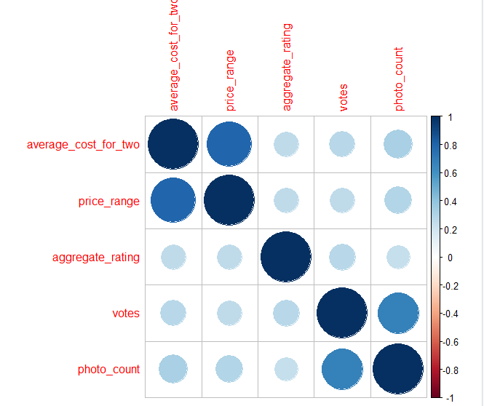
Visualisations Correlation Heatmap
Correlations between featured of restaurant

Slide 9
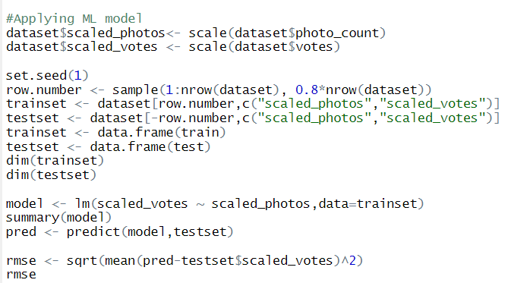
Algorithm
The algorithm that we have used is
Simple Linear Regression Model

Slide 10
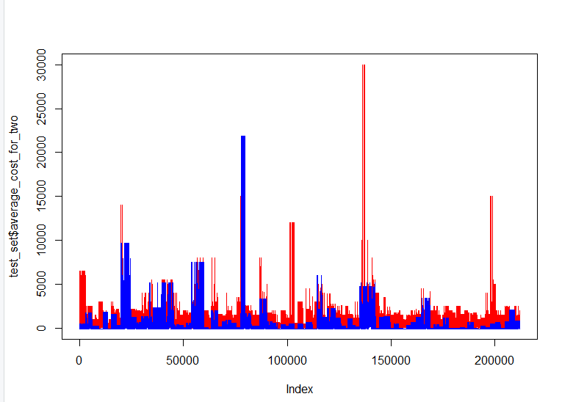
Prediction (Blue) VS Original (Red)

Slide 11
Conclusion
From the Bar plot we can conclude that majority of restaurants open their branches, invest in major/metro cities.
From the Pie chart we infer that majority of restaurants lies in categories such as Quick bite, Casual dining and rest lies in bakery, bars, fine dining etc.
From horizontal Bar plot, its clear that top competitors in dining industries are Domino’s, KFC, Subway and more.
From correlation heatmap, we get that more social activeness of restaurants such as adding photos of restaurants, attracts crowd who share their review.
We applied Simple Linear Regression model to predict:
Number of votes depending on count of photos available online.
The aggregate price for two people according to votes and aggregate rating.

Slide 12
THANK YOU

